Slide 1
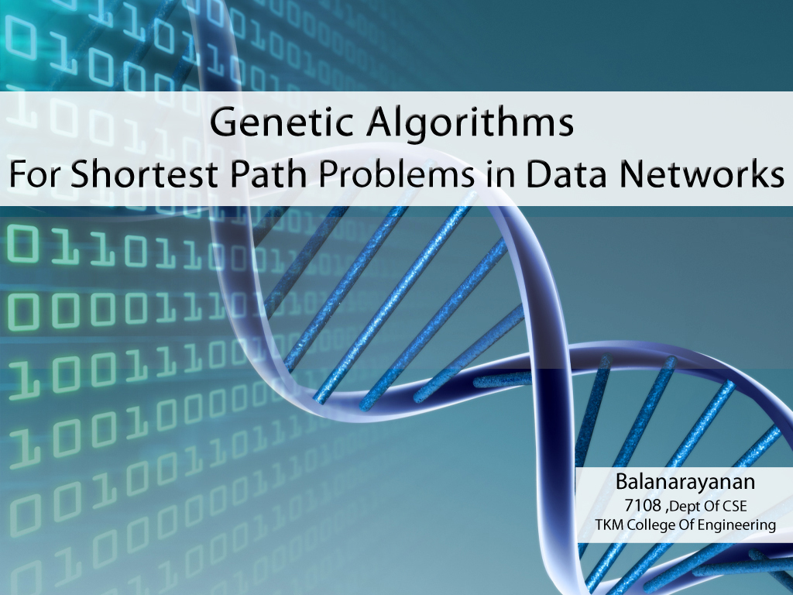
Evolutionary computation
By: F. Karimi
Department of Computer Science
University of Tabriz
Fall 2015

Slide 2

Introduction
Intelligence can be defined as the capability of a system to adapt its behavior to an ever-changing environment.
We are products of evolution, and thus by modelling the process of evolution, we might expect to create intelligent behavior.
Evolutionary computation simulates evolution on a computer.
The result of such a simulation is a series of optimization algorithms, usually based on a simple set of rules.
Optimization iteratively improves the quality of solutions until an
optimal, or at least feasible, solution is found.

Slide 3
Introduction
The evolutionary approach to machine learning is based on computational models of natural selection and genetics.
We call them evolutionary computation, an umbrella term that combines genetic algorithms, evolution strategies and genetic programming.
All these techniques simulate evolution by using the processes of selection, mutation and reproduction.
More precisely, evolutionary algorithms maintain a population of structures that evolve according to rules of selection and other operators, such as recombination and mutation.

Slide 4
Search Techniques
Calculus Base Techniques
Guided random search techniques
Enumerative Techniques
Fibonacci
Sort
DFS
Dynamic Programming
BFS
Tabu Search
Hill Climbing
Simulated Anealing
Evolutionary Algorithms
Genetic Programming
Genetic Algorithms

Slide 5
Classification
Several different methods of evolutionary computation are now known.
They all simulate natural evolution, generally by creating a population of individuals, evaluating their fitness, generating a new population through genetic operations, and repeating this process a number of times.
Genetic Programming (GP)
Genetic Algorithm (GA)
Evolutionary Programming (EP)
Evolutionary Strategy(ES)

Slide 6

History
Genetic Algorithms (GA) are a class of stochastic search algorithms based on biological evolution.
They have been used successfully for tackling large, complex and multi modal search spaces.
Originally developed by John Holland (1975).
Inspired by the biological evolution process.
Uses concepts of “Natural Selection” and “Genetic
Inheritance” (Darwin1859).
Particularly well suited for hard problems where little is
known about the underlying search space.
Widely-used in business, science and engineering.

Slide 7
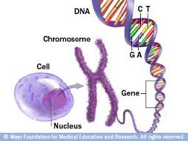
Biological background
Each cell of a living organisms contains chromosomes - strings of DNA
Each chromosome contains a set of genes - blocks of DNA
Reproduction involves recombination of genes from parents
The fitness of an organism is how much it can reproduce before it dies

Slide 8
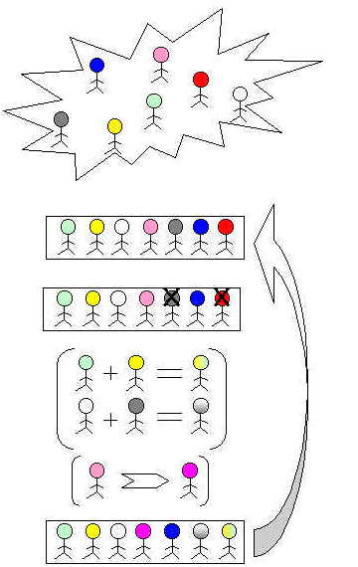
GA overview
Genetic Algorithms search by simultaneously considering a number of potential solutions.
These solutions are selected by using an objective fitness function.
Selected solutions are then manipulated by using operators such as crossover and mutation to expand the search.
As a result, after a number of successive reproductions, the less fit chromosomes become extinct, while those best able to survive gradually come to dominate the population.

Slide 9
GA overview
Selection
Initial population
Crossover & mutation
Next population
Intermediate population
(mating pool)
One Generation
Replacement

Slide 10
Phenotype vs. Genotype
Phenotype space
Genotype space = {0,1}^{L}
Encoding
(representation)
10010001
10010010
010001001
011101001
Decoding
(inverse representation)
Chromosome (individual)

Slide 11
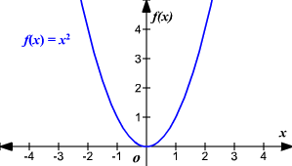
Objective function
Two mechanisms link a GA to the problem it is solving: encoding and evaluation.
GAs use an objective function to guide the search towards areas of optimal solution in the search landscape.
This function evaluates the fitness of each individual and is there to make sure that the fitter members of the population have a higher chance of being selected for reproduction.
Fitness functions are specific to a search space.
constraint
Max f(x)=x² 0<x<31

Slide 12
Encoding
Choosing a good encoding is vital since the members of the population use an encoding to represent the solutions and they are directly affected by the search.
Coding, mapping from phenotypes to genotypes, is performed in a number of ways such as Binary, Real-valued, Adaptive and …
Gene
x=13
f(x)=169
1 | 0 | 1 | 1 | 0
Chromosome

Slide 13
Binary Encoding
Every chromosome is a string of bits, 0 or 1
Ex: Knapsack Problem Encoding: Each bit specifies if the thing is in knapsack or not
Chromosome A
101101100011
Chromosome B
010011001100

Slide 14
Permutation Encoding
Every chromosome is a string of numbers, which represents the number in the sequence. Used in ordering problems.
Ex: Traveling Sales Person Problem
Encoding: Chromosome represents the order of cities, in which the salesman will visit them
Chromosome A
1 5 3 2 6 4 7 9 8
Chromosome B
8 5 6 7 2 3 1 4 9

Slide 15
Real valued
Every chromosome is a string of some values. Values can be form numbers, real numbers or characters.
Ex: Finding weights for neural network
The problem: To find the weights of synapses connecting input to hidden layer and hidden layer to output layer
Encoding: Each value chromosome represent the corresponding weights
Chromosome A | 1.2324 5.3243 0.4556 2.3293 2.4545
Chromosome B | ABDJEIFJDHDIERJFDLDFLFEGT
Chromosome C | (back), (back), (right), (forward), (left)

Slide 16
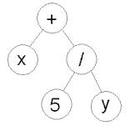
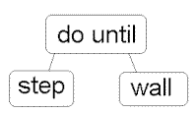
Tree Encoding
Every chromosome is a tree of some objects, such as functions or commands in a programming language
Used for evolving programs or expressions in Programming Languages
Ex: Finding a function from given values
The problem: Some input and output values are given. Task is to find a function, which will give the best output to all inputs
Encoding: Chromosome are functions represented in a tree
( + x ( / 5 y ) )
( do_until step wall )

Slide 17
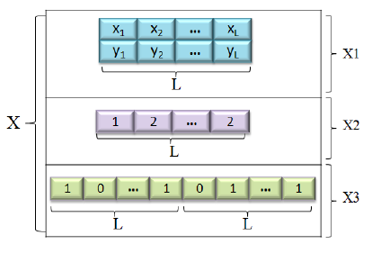
Hybrid encoding

Slide 18
Initial population
Genetic algorithm has a main generational process cycle.
This cycle is driven mainly by generation number.
Within this cycle, an initial population is created; each individual is coded so as to be represented numerically.
Then each individual of population is assigned a fitness value which is a parameter with respect to which each individual is evaluated whether or not to live in subsequent generations.

Slide 19
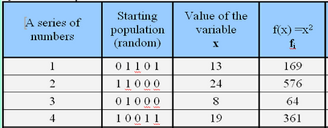
Initial population
Pop size=4
Max f(x)=x² 0<x<31
19

Slide 20
Selection strategy
Chromosomes are selected from the population to be parents to crossover and produce offspring.
This process involves randomly picking members of the population that are used for crossover and mutation and creation of the next population.
Main idea: better individuals get higher chance
Tournament
Roulette wheel
SUS
Rank based

Slide 21
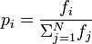
Selection strategy- roulette wheel
Implementation: roulette wheel technique
Assign to each individual a part of the roulette wheel
Spin the wheel n times to select n individuals
1/6 = 17%
fitness(A) = 3
B
A
C
fitness(B) = 1
3/6 = 50%
2/6 = 33%
fitness(C) = 2

Slide 22
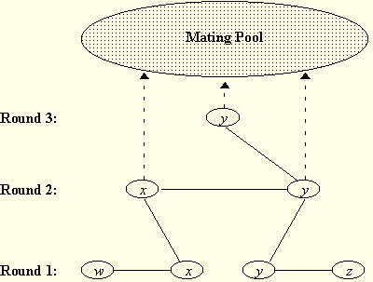
Selection strategy-Tournament
The tournament selection strategy provides selective pressure by holding a tournament competition among N individuals.
The best individual from the tournament is the one with the highest fitness, which is the winner of tournament.
Tournament competitions and the winner are then come back to the population.

Slide 23
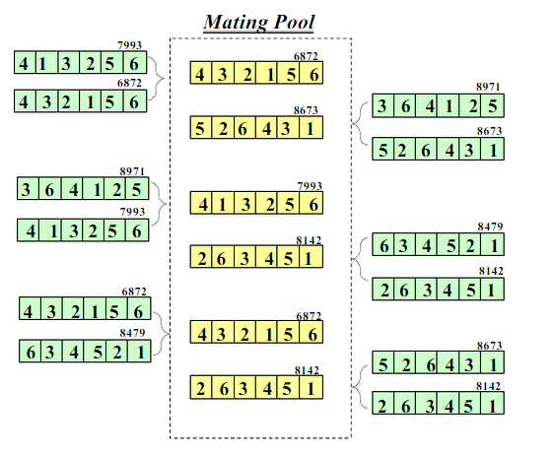
Selection- the result

Slide 24

Elitism
Main idea: copy the best chromosomes (solutions) to new population before applying crossover and mutation
When creating a new population by crossover or mutation the best chromosome might be lost
Elitism can very rapidly increase performance of GA, because it prevents losing the best found solution

Slide 25
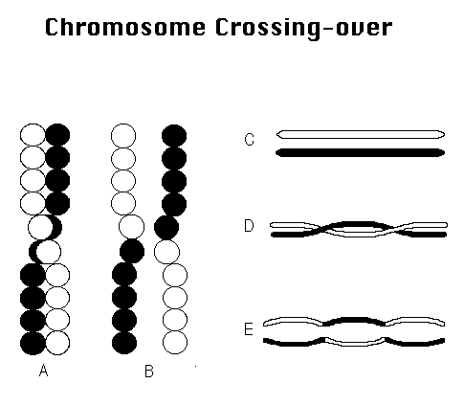
Crossover operator
Crossover operator is a method for sharing information between chromosomes.
Selected parents reproduce the offspring by performing a crossover operation on the chromosomes.
If a pair of chromosomes does not cross over, then chromosome cloning takes place, and the offspring are created as exact copies of each parent.

Slide 26
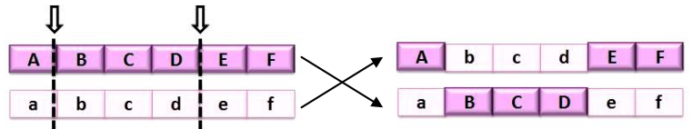
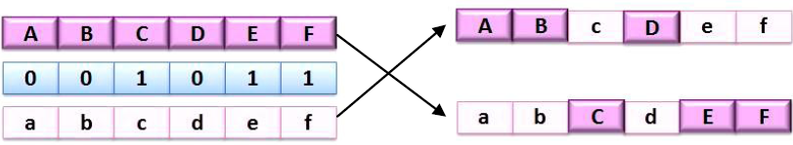
Crossover operator
Two point crossover
Uniform crossover
Parent 1
offspring 1
Parent 2
offspring 2
Parent 1
offspring 1
Mask
Parent 2
offspring 2
0.6< Probability of crossover (Pc) <0.9

Slide 27
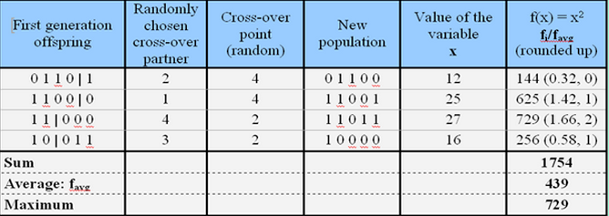
Crossover effects
Exploration
Remove
Invalid offspring!!!
Repair
Penalize

Slide 28
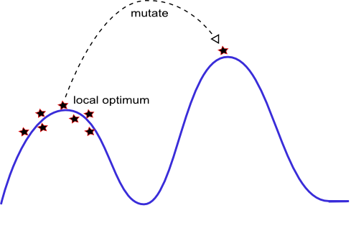
Mutation operator
Mutation is a random process where once the genes are replaced by another to produce a new genetic structure.
In genetic algorithms, mutation is randomly applied with low probability and modifies elements in the chromosomes.
mutation operator does play a role of local random search within the framework of the generational process cycle
Exploitation

Slide 29
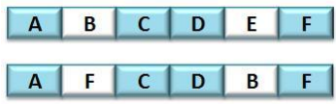
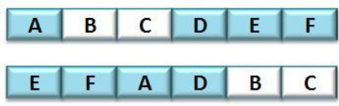
Mutation operator
Mutation is considered a secondary search operator for a GA and crossover is considered the main means of GA search.
Before mutation
Swap mutation
After mutation
Before mutation
Insertion mutation
After mutation
0.01< Probability of mutation (Pm) <0.001
29

Slide 30
Termination
Termination is the criterion by which the genetic algorithm decides whether to continue searching or stop the search.
Generation Number - A termination method that stops the evolution when the user-specified max number of evolutions have been run. This termination method is always active.
Evolution Time
Fitness Threshold
Population Convergence
The entire set of generations is called a run. At the end of a run, we expect to find one or more highly fit chromosomes.
Flow chart

Slide 31
GA steps
Step 1: Represent the problem variable domain as a chromosome of a fixed length, choose the size of a chromosome population N, the crossover probability p_{c} and the mutation probability p_{m}.
Step 2: Define a fitness function to measure the performance, or fitness, of an individual chromosome in the problem domain. The fitness function establishes the basis for selecting chromosomes that will be mated during reproduction.
Step 3: Randomly generate an initial population of chromosomes of size N: x₁ ; x₂ ; . . . ; x_{N}
Step 4: Calculate the fitness of each individual chromosome:
f(x₁), f(x₂), ….., f(x_{n} )

Slide 32
GA steps
Step 5: Select a pair of chromosomes for mating from the current population. Parent chromosomes are selected with a probability related to their fitness. Highly fit chromosomes have a higher probability of being selected for mating than less fit chromosomes.
Step 6: Create a pair of offspring chromosomes by applying the genetic operators – crossover and mutation.
Step 7: Place the created offspring chromosomes in the new population.
Step 8: Repeat Step 5 until the size of the new chromosome population becomes equal to the size of the initial population, N.
Step 9: Replace the initial (parent) chromosome population with the new (offspring) population.
Step 10: Go to Step 4, and repeat the process until the termination criterion is satisfied

Slide 33
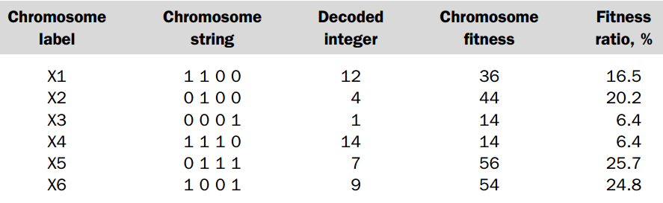
A simple example
Finding maximum value of the function (15x – x²) 0<x<15
Size of the chromosome population N is 6, the crossover probability p_{c} equals 0.7, and the mutation probability p_{m} equals 0.001.
Initial population of chromosomes by filling six 4-bit strings with randomly generated ones and zeros.

Slide 34
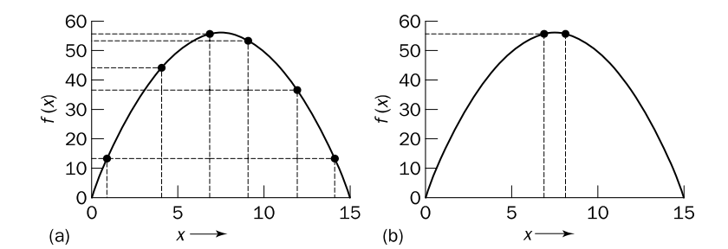
A simple example
The fitness function and chromosome locations: (a) chromosome initial locations; (b) chromosome final locations
The size of the chromosome population remains unchanged from one generation to the next.

Slide 35
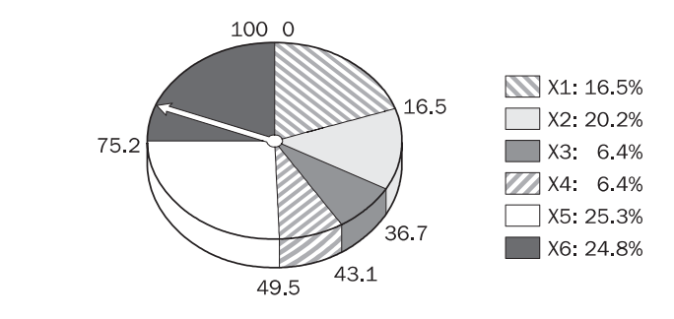
A simple example
To select a chromosome for mating, a random number is generated in the interval [0, 100] and the chromosome whose segment spans the random number is selected.
In our example, we have an initial population of six chromosomes. Thus, to establish the same population in the next generation, the roulette wheel would be spun six times.

Slide 36
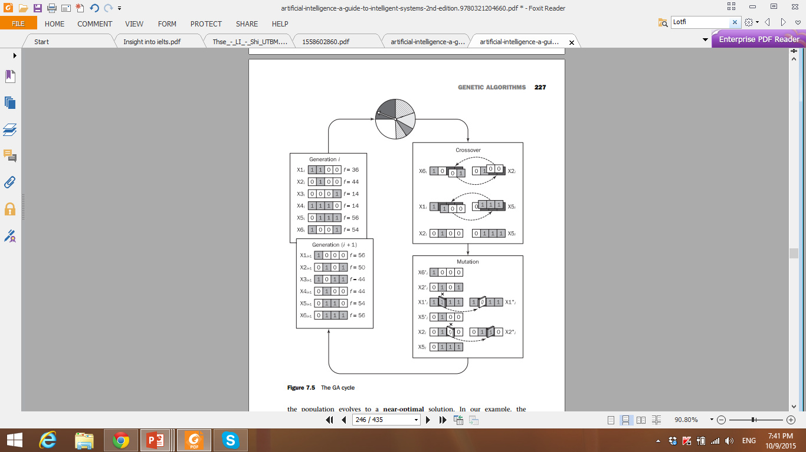
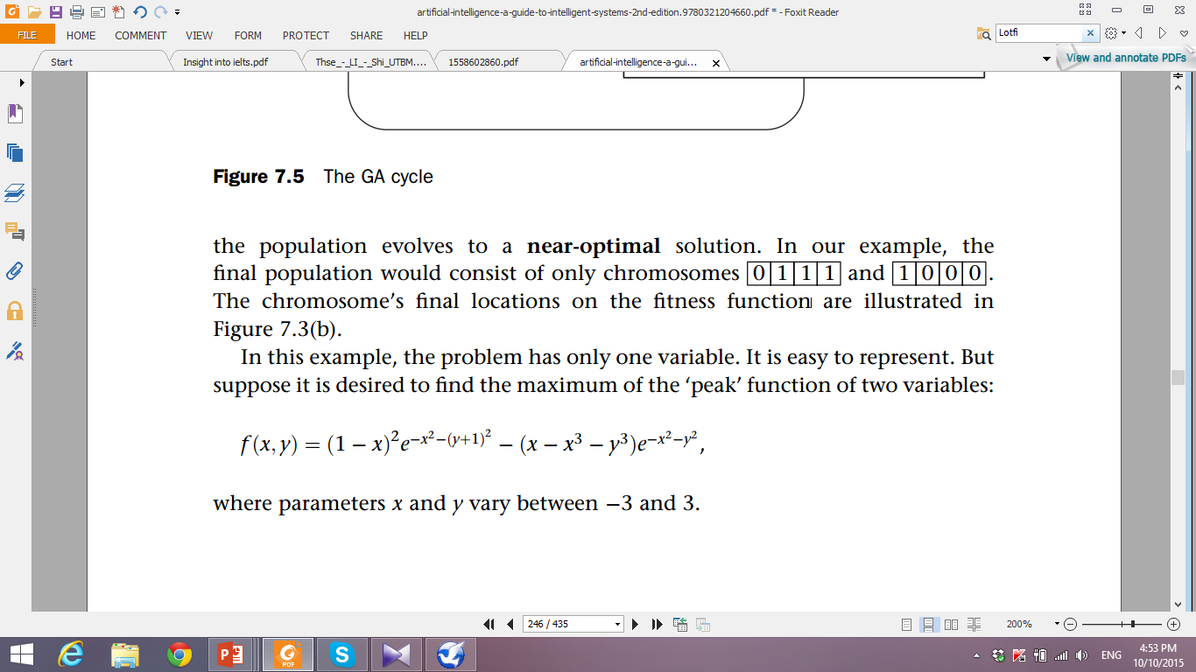
GA cycle
After selection and crossover, the average fitness of the chromosome population has improved and gone from 36 to 42.
The final population would consist of only chromosomes:

Slide 37
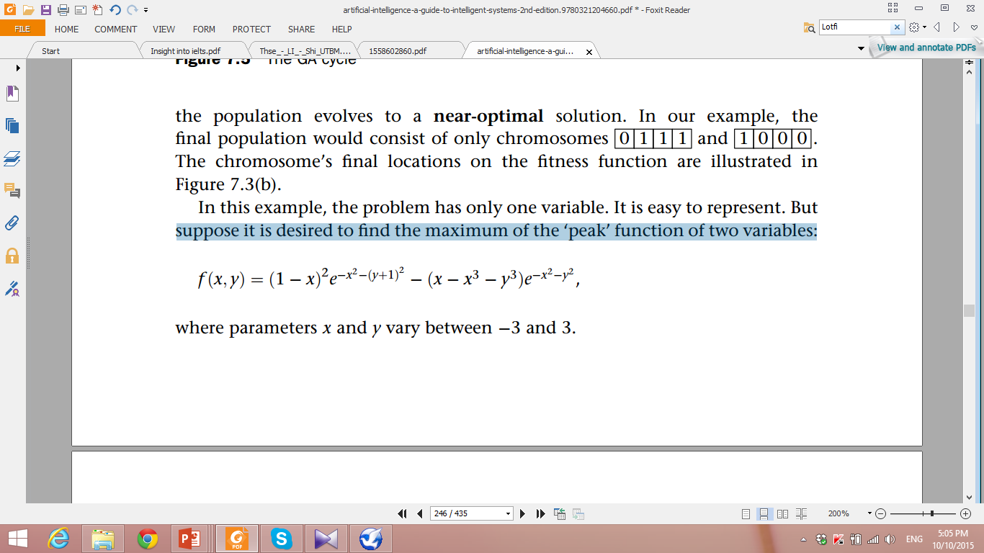
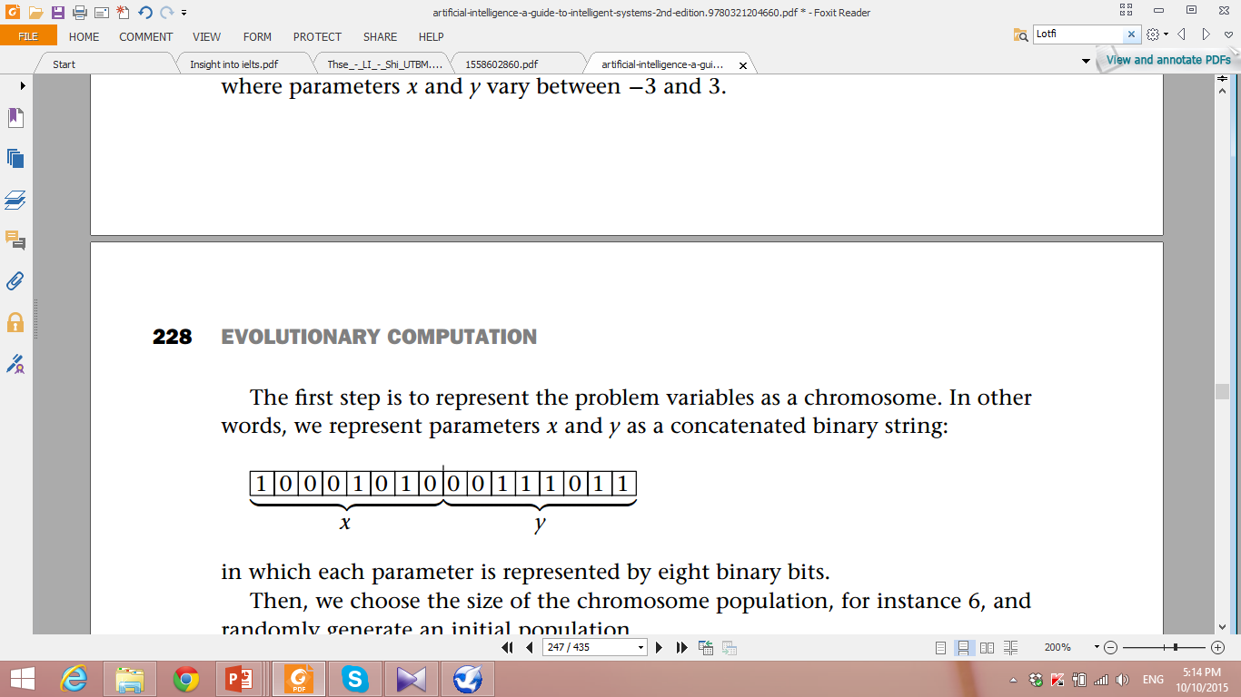
More complex example- peak function
Suppose it is desired to find the maximum of the ‘peak’ function of two variables:
To calculate the fitness of each chromosome. This is done in two stages: First, a chromosome is decoded by converting it into two real numbers, x and y, in the interval between -3 and 3.
-3<x, y<3

Slide 38
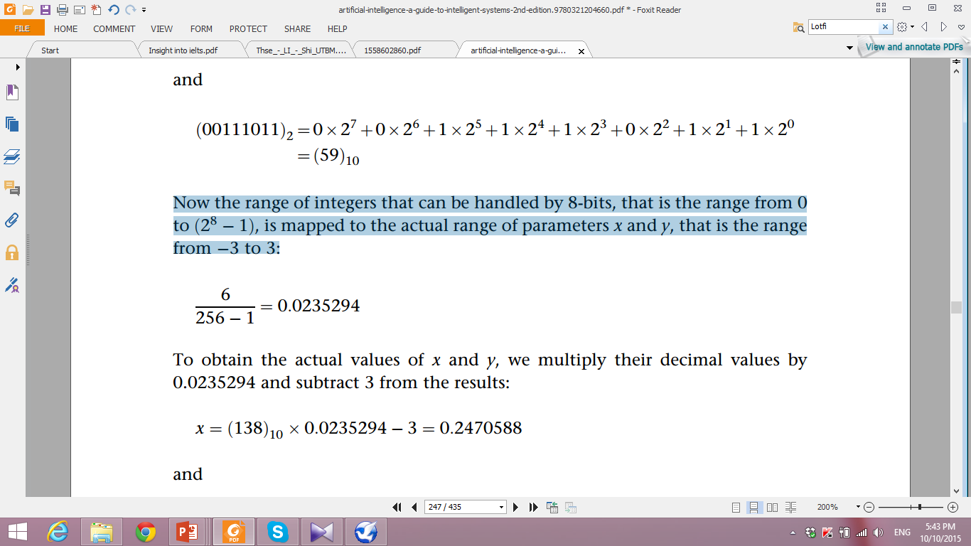
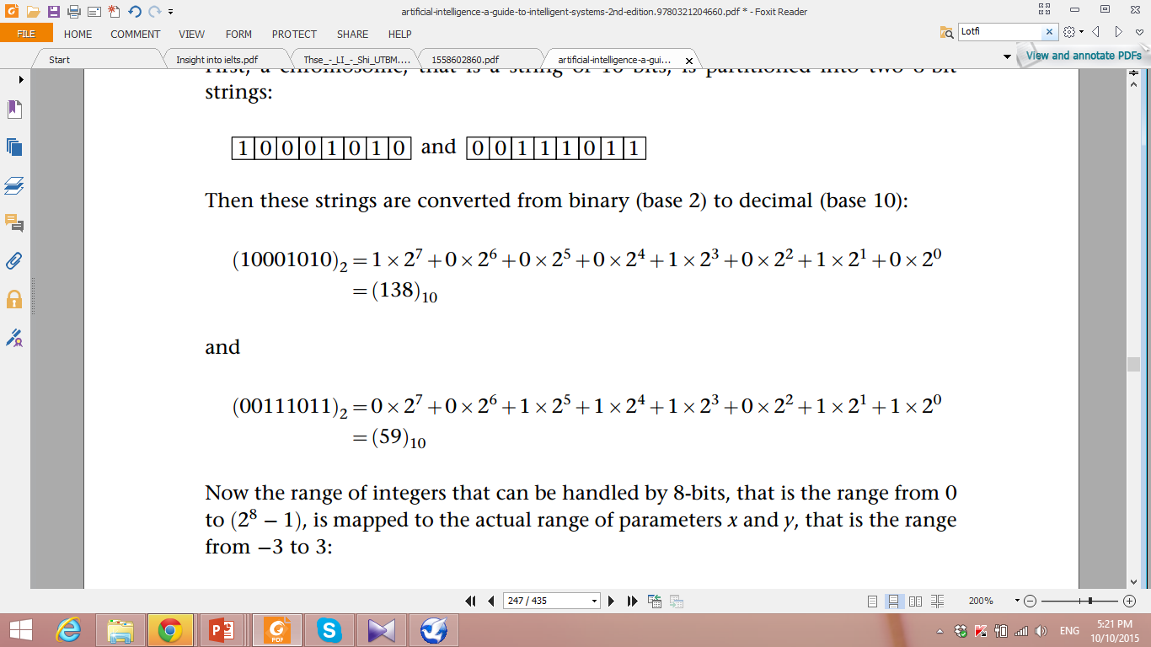
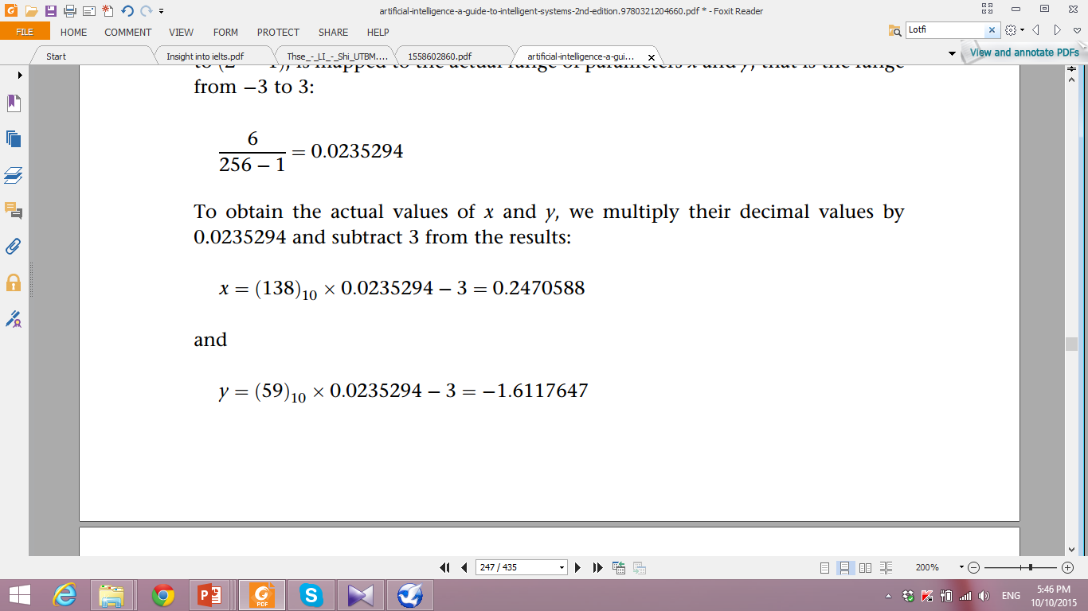
Peak function
Now the range of integers that can be handled by 8-bits, that is the range from 0 to (2⁸-1), is mapped to the actual range of parameters x and y, that is the range from -3 to 3:
To obtain the actual values of x and y, we multiply their decimal values by 0.0235294 and subtract 3 from the results:

Slide 39
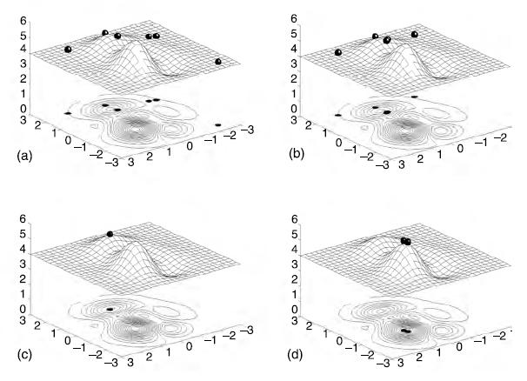
Peak function- the results
Whether or not an optimal solution is
being reached?
Crossover=0.7
Mutation= 0.001
Iteration number= 100

Slide 40
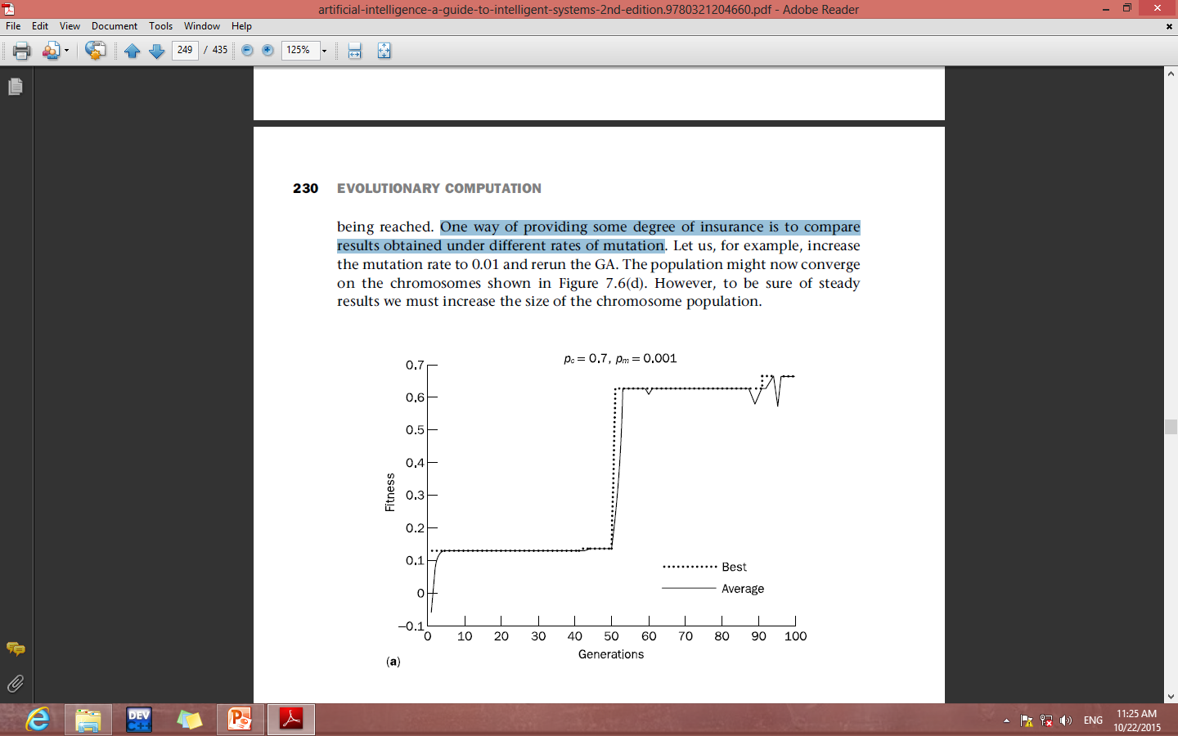
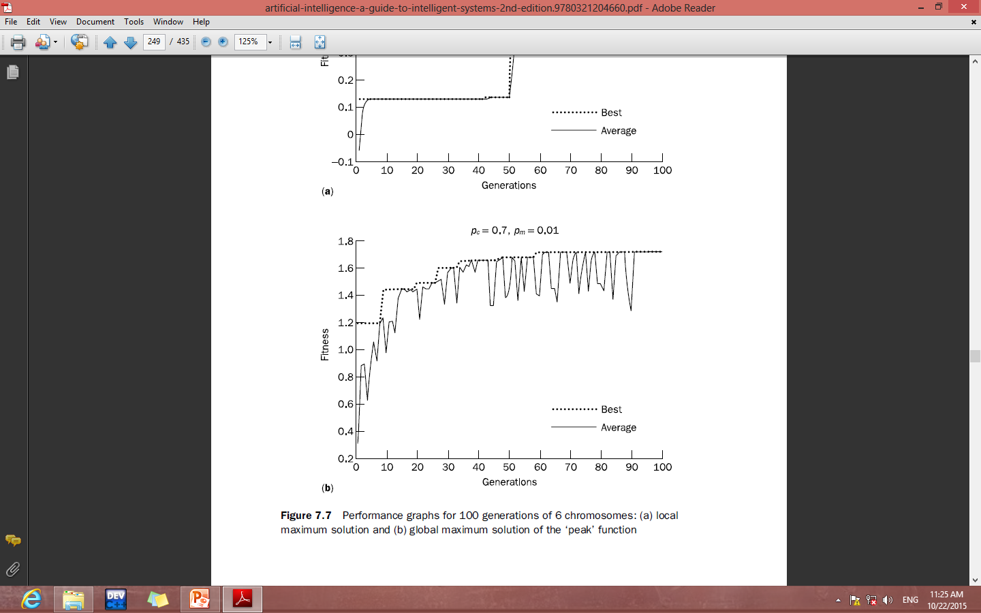
Peak function- performance graph
One way of providing some degree of insurance is to compare results obtained under different rates of mutation
Local maximum solution
global maximum solution

Slide 41
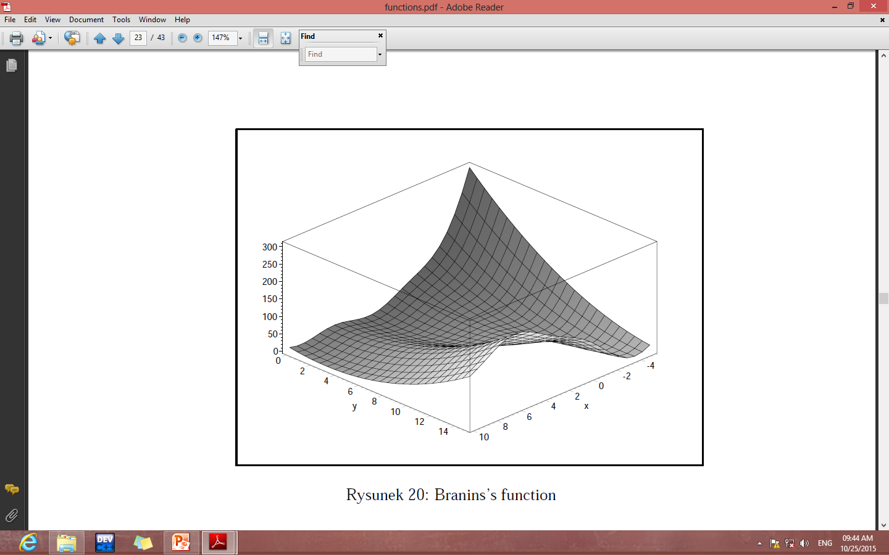
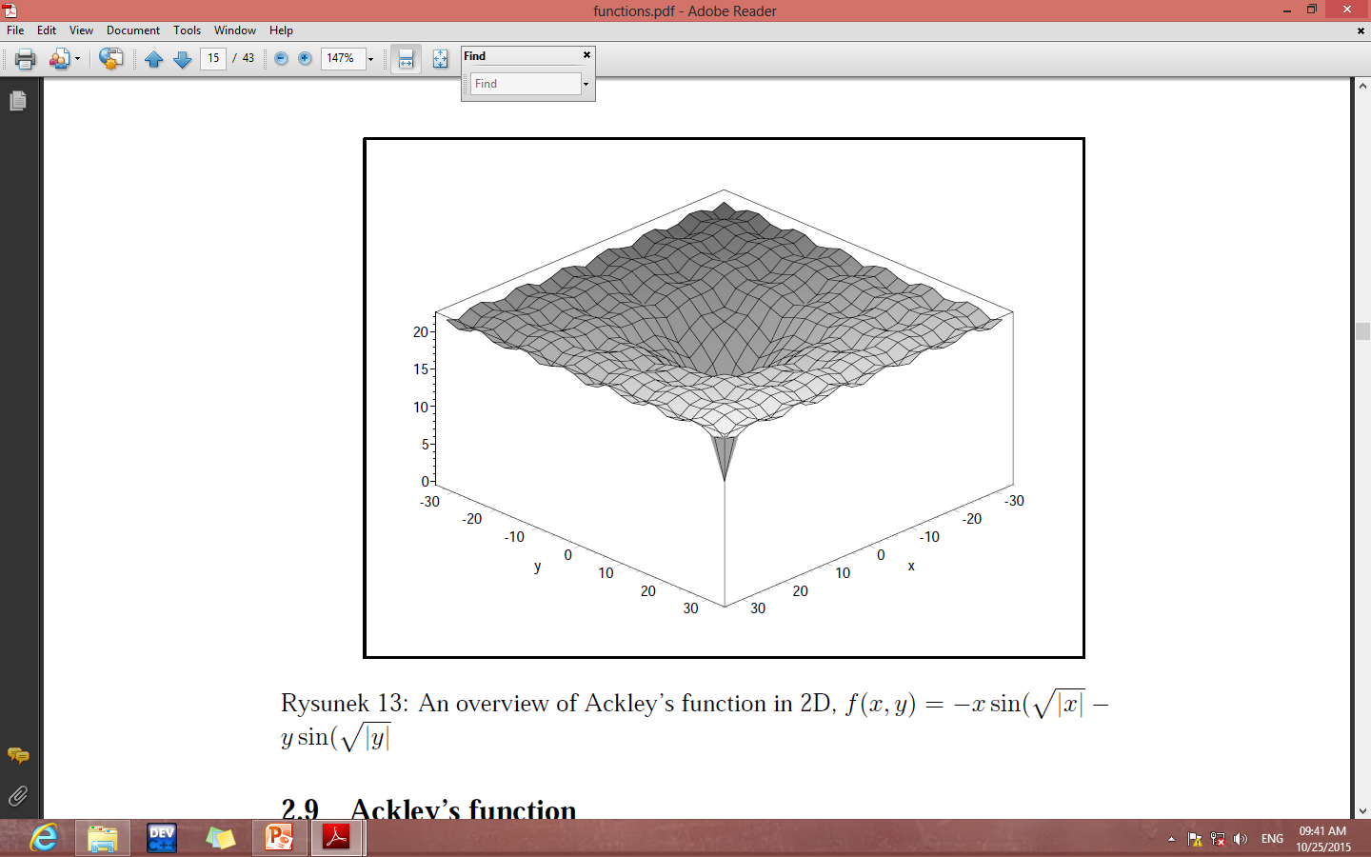
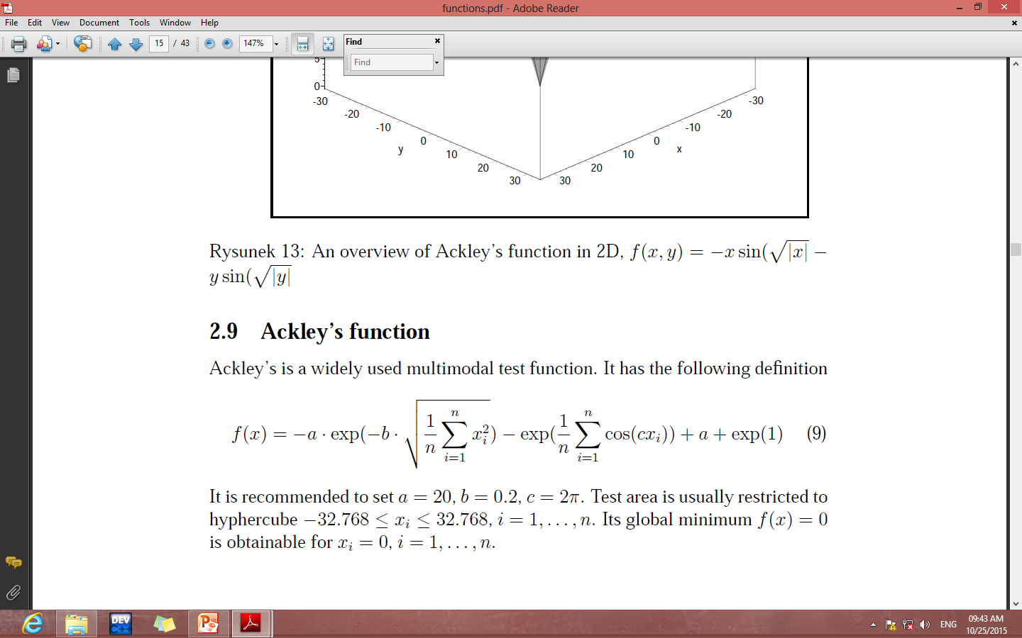
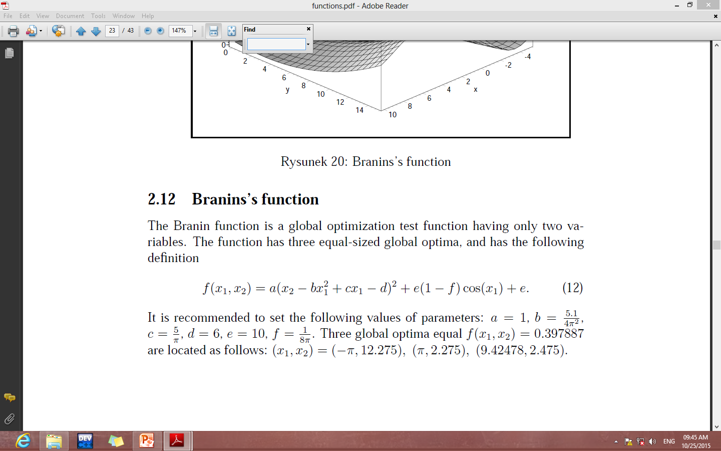
GA test- reliability test
Quality of optimization procedures are frequently evaluated by using common standard literature benchmarks.

Slide 42
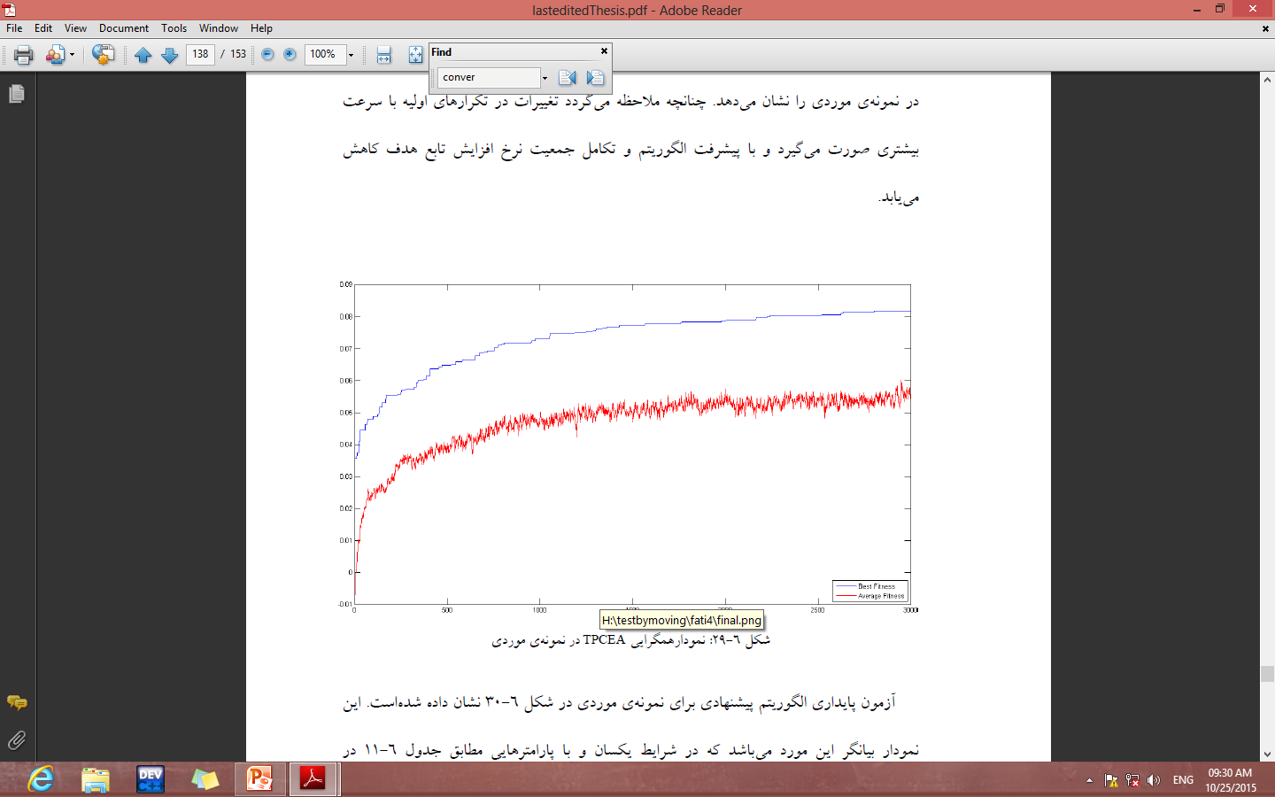
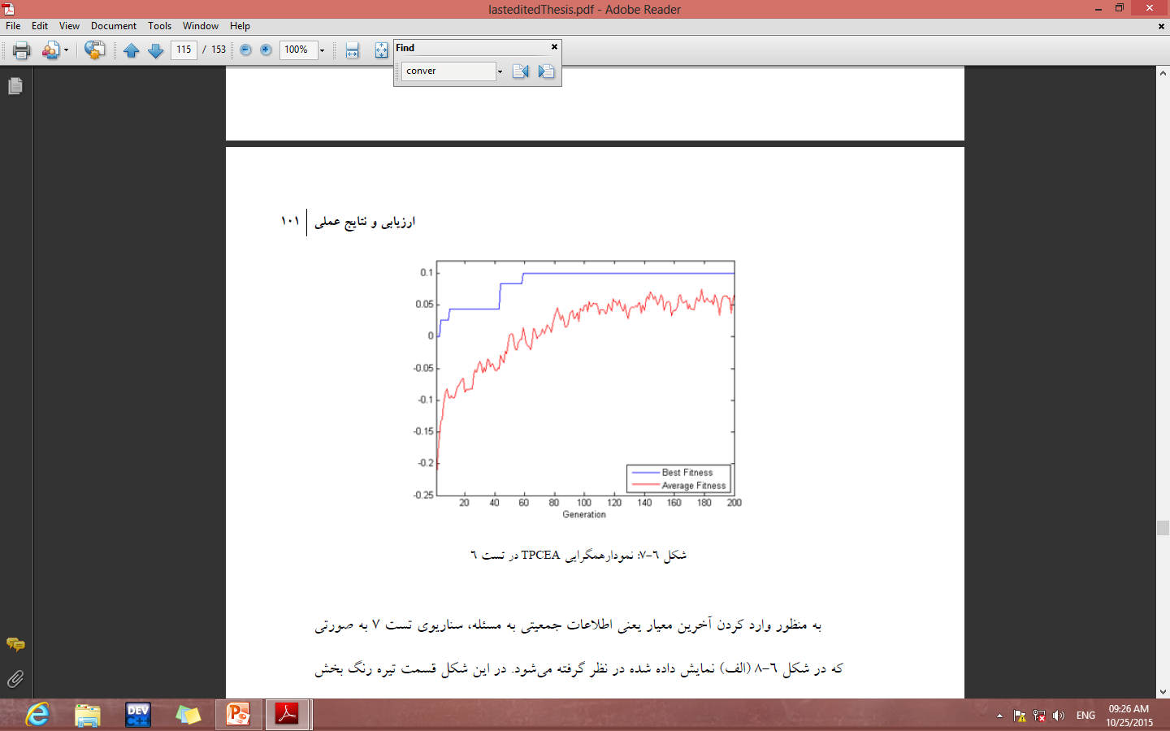
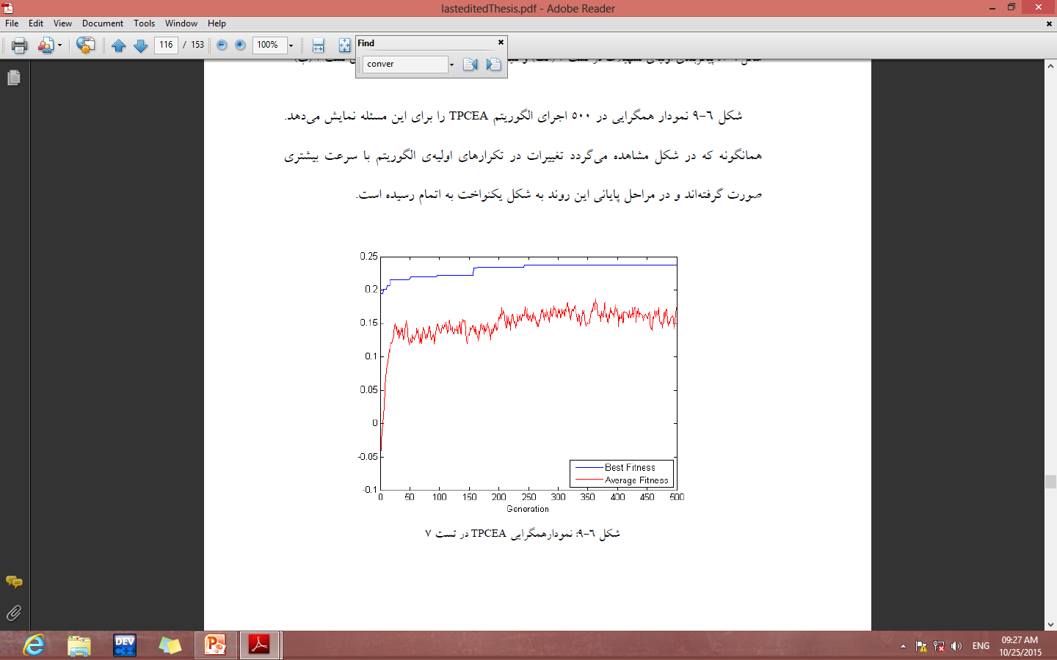
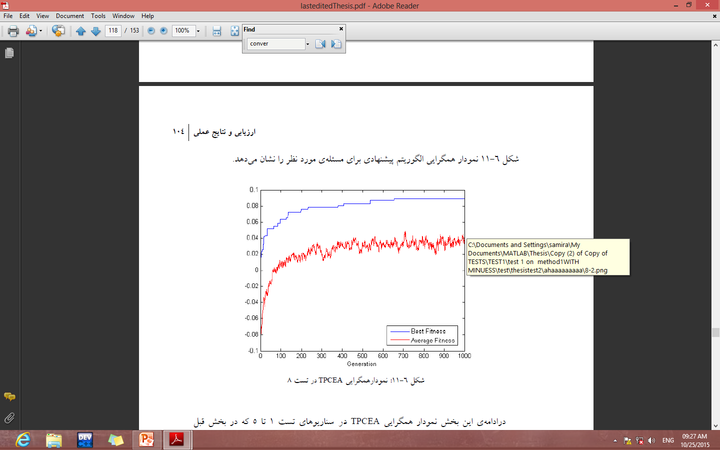
GA test-performance (convergence) graph

Slide 43
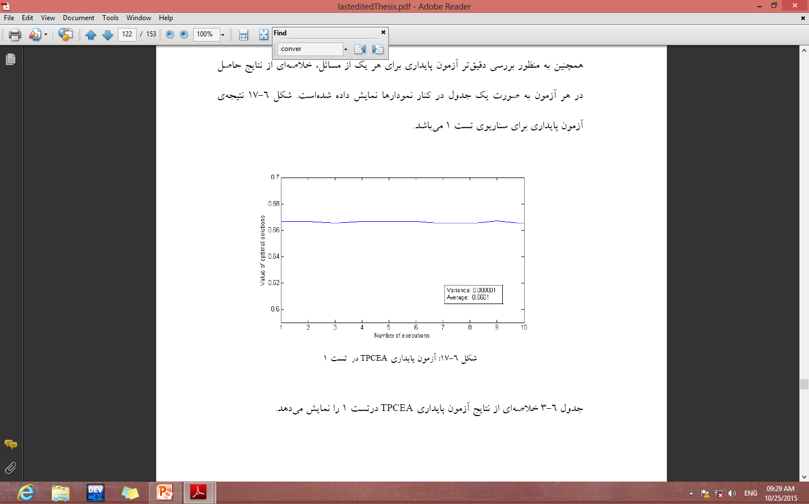
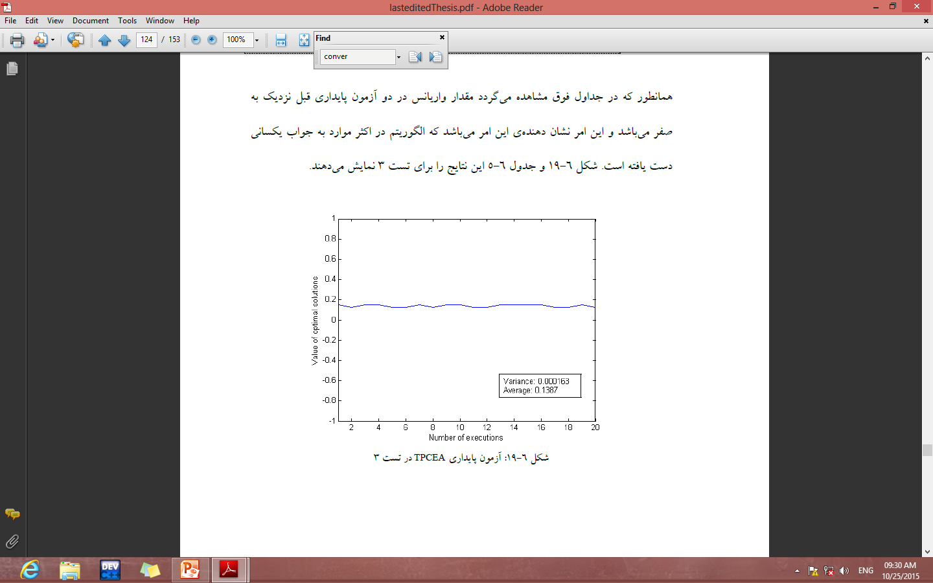
GA test- stability graph

Slide 44
Some GA Application Types

Slide 45
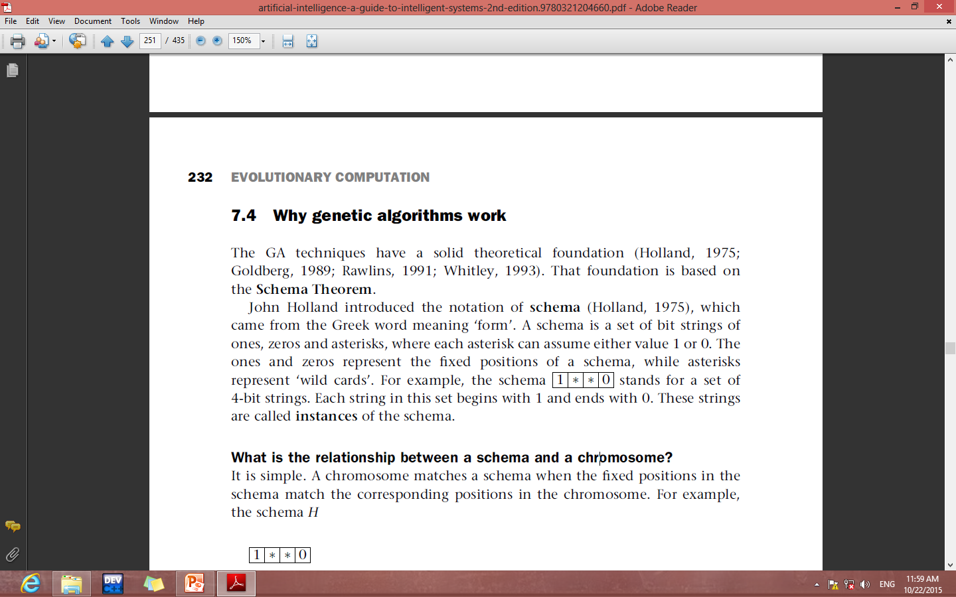
Why genetic algorithms work
The GA techniques have a solid theoretical foundation. That foundation is based on the Schema Theorem.
A schema is a set of bit strings of ones, zeros and asterisks, where each asterisk can assume either value 1 or 0.
The ones and zeros represent the fixed positions of a schema, while asterisks represent ‘wild cards’.
stands for a set of 4-bit strings. Each string in this set begins with 1 and ends with 0. These strings are called instances of the schema.

Slide 46
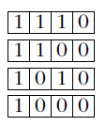
Relationship between a schema and a chromosome
chromosome matches a schema when the fixed positions in the schema match the corresponding positions in the chromosome.
These chromosomes are said to be instances of the schema H.
The number of defined bits (non-asterisks) in a schema is called the order.
The schema H, for example, has two defined bits, and thus its order is 2.

Slide 47
Relationship between a schema and a chromosome
In short, genetic algorithms manipulate schemata when they run. If GAs use a technique that makes the probability of reproduction proportional to chromosome fitness, then according to the Schema Theorem (Holland, 1975), we can predict the presence of a given schema in the next chromosome generation.
In other words, we can describe the GA’s behavior in terms of the increase or decrease in the number of instances of a given schema (Goldberg, 1989).
a schema with above-average fitness will indeed tend to occur more
frequently in the next generation of chromosomes, and a schema with below average fitness will tend to occur less frequently.

Slide 48
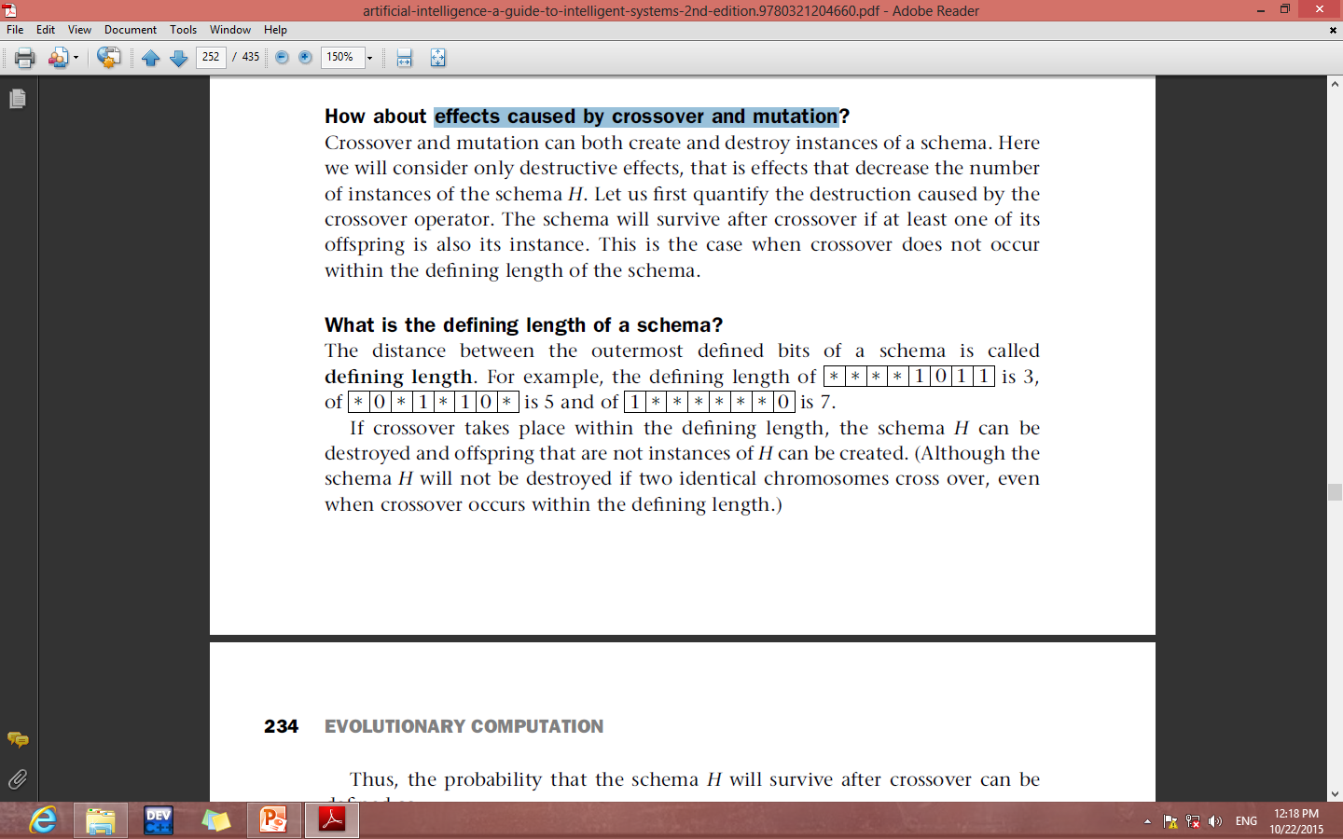
Effects caused by crossover and mutation
Crossover and mutation can both create and destroy instances of a schema.
Here we will consider only destructive effects, that is effects that decrease the number of instances of the schema H.
The schema will survive after crossover if at least one of its offspring is also its instance.
This is the case when crossover does not occur within the defining length of the schema.
The distance between the outermost defined bits of a schema is called defining length.
3
5

Slide 49
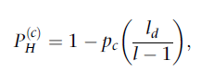
Effects caused by crossover and mutation
If crossover takes place within the defining length, the schema H can be destroyed and offspring that are not instances of H can be created.
Thus, the probability that the schema H will survive after crossover can be
defined as:
l and l_{d} are, respectively, the length and the defining length of the schema H.
It is clear, that the probability of survival under crossover is higher for short schemata rather than for long ones.

Slide 50
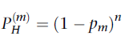
Let p_{m} be the mutation probability for any bit of the schema H, and n be the order of the schema H.
Then (1- p_{m}) represents the probability that the bit will not be mutated, and thus the probability that the schema H will survive after mutation is determined as:
It is also clear that the probability of survival under mutation is higher for
low-order schemata than for high-order ones.

Slide 51
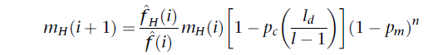
Schema Theorem
This equation describes the growth of a schema from one generation to the next. It is known as the Schema Theorem:
Because equation considers only the destructive effects of crossover and mutation, it gives us a lower bound on the number of instances of the schema H in the next generation.

Slide 52
Advantages of GA
A fastest search technique
GAs will produce "close" to optimal results in a "reasonable" amount of time
Suitable for parallel processing
Fairly simple to develop
Makes no assumptions about the problem space

Slide 53
Drawbacks of GA
Number of permutations of functions and variables.
The search space is vast.
It requires a lot of computer work, even when a good set of operations, terminals and controlling algorithm are chosen.

Slide 54
Conclusion
Genetic algorithms are a very powerful tool, but need to be applied intelligently.
For example, coding the problem as a bit string may change the nature of the problem being investigated.
In other words, there is a danger that the coded representation becomes a problem that is different from the one we wanted to solve.

Slide 55

Thanks for your attention.

Slide 56
An evolution strategy is a purely numerical optimization procedure that is similar to a focused Monte Carlo search.
Unlike genetic algorithms, evolution strategies use only a mutation operator.
In addition, the representation of a problem in a coded form is not required.
Evolution strategies are used in technical optimization problems when no analytical objective function is available, and no conventional optimization method exists – only the engineer’s intuition.

Slide 57
Genetic programming is a recent development in the area of evolutionary computation.
It was greatly stimulated in the 1990s by John Koza.
Genetic programming applies the same evolutionary approach as genetic algorithms.
However, genetic programming is no longer breeding bit strings that represent coded solutions but complete computer programs that solve a problem at hand.
Solving a problem by genetic programming involves determining the set of arguments, selecting the set of functions, defining a fitness function to evaluate the performance of created computer programs, and choosing the method for designating a result of the run.

